Slide 1


PyTorch 2 and TorchInductor
Jason Ansel
Research Scientist, Meta
Horace He
Software Engineer, Meta
Notes:
Soumith slides: https://docs.google.com/presentation/d/14eNhuN3BentpRrVjjAHGMuAOR2Vp-VYsyCnCUe04IJQ/edit#slide=id.g19de3113aee_4_280
Title:
PyTorch 2.0: Faster machine learning through dynamic Python bytecode translation
Abstract:
PyTorch 2.0 uses compilers to deliver faster training and inference
without sacrificing the usability and flexibility PyTorch is known
for. PyTorch 2.0 is fully backwards compatible and continues to
provide an interactive, extensible, easy to debug, and Pythonic
programming environment for AI researchers, data scientists and
engineers. Across 163 models in our benchmark set we find 93% model
coverage and a geometric mean training speedup of approximately 43% on
an NVIDIA A100.
This talk will cover key technologies behind PyTorch 2.0: TorchDynamo
and TorchInductor. TorchDynamo is a Python-level JIT compiler
designed to make unmodified PyTorch programs faster. TorchDynamo hooks
into the frame evaluation API in CPython to dynamically modify Python
bytecode right before it is executed. It rewrites Python bytecode in
order to extract sequences of PyTorch operations into an FX Graph
which is then just-in-time compiled with many extensible backends. It
creates this FX Graph through bytecode analysis and is designed to
generate smaller graph fragments that can be mixed with Python
execution to get the best of both worlds: usability and performance.
TorchInductor is the new compiler backend included in PyTorch 2.0. It
translates PyTorch programs into OpenAI's Triton for GPUs and
OpenMP/C++ for CPUs. TorchInductor is able to handle the flexibility
and dynamism of PyTorch by using similar abstractions to PyTorch eager
mode. It introduces a new define-by-run loop level intermediate
representation (IR) to make it easy to add new operator lowerings.
Finally, it is implemented in Python, so it is easy for PyTorch users
to extend and modify to meet their needs.
Bio:
Jason Ansel is a Principal Research Scientist at Meta AI and a
technical lead for PyTorch compilers. He started the TorchDynamo and
TorchInductor projects, which bring flexible graph capture and a high
performance compiler to PyTorch 2.0. He received a Ph.D. from MIT
CSAIL in 2014 (advisor Saman Amarasinghe) with research focusing on
the boundary of machine learning, compilers, and programming
languages.

Slide 2
INTRODUCING
cmodel = torch.compile(model)
Notes:
We feel pretty happy about the progress we’ve made, on graph acquisition and compilation and the speedups we are seeing by wrapping the model as-is.
So, I want to introduce the simplest API that we could think of to expose this technology.

Slide 3
TORCHINDUCTOR PRINCIPLES
PyTorch Native Similar abstractions to PyTorch eager to allow support for nearly all of PyTorch, with a thin translation layer.
Python First A pure python compiler makes TorchInductor easy to understand and hackable by users. Generates Triton and C++.
Breadth First Early focus on supporting a wide variety of operators, hardware, and optimization. A general purpose compiler, that can scale.

Slide 4
TORCHINDUCTOR TECHNOLOGIES
Define-By-Run Loop-Level IR Direct use of Python functions in IR definitions allows for rapidly defining lowering with little boilerplate.
Dynamic Shapes & Strides Uses SymPy to reason about shapes, indexing, and managing guards. Symbolic shapes from the ground up.
Reuse State-Of-The-Art Languages Generates output code in languages popular for writing handwritten kernels:
Triton for GPUs
C++/OpenMP for CPUs

Slide 5
TORCHINDUCTOR COMPILER STACK
AotAutograd
Decomposes into smaller operator set
Capture forwards + backwards
Some inductor specific decomps included in this step
Inductor Graph Lowerings
Remove views, broadcasting, and simplify indexing
Rematerialize vs reuse decisions
Layout tuning and optimization
Loop order
Inductor Scheduling
Horizontal / vertical fusion decisions
Reduction fusions
Tiling
Memory planning and buffer reuse
In-place memory buffers
Autotuning / kernel selection
Wrapper Codegen
Outer code that calls kernels and allocates memory
(Replaces interpreter)
Backend Codegen
Triton
C++

Slide 6
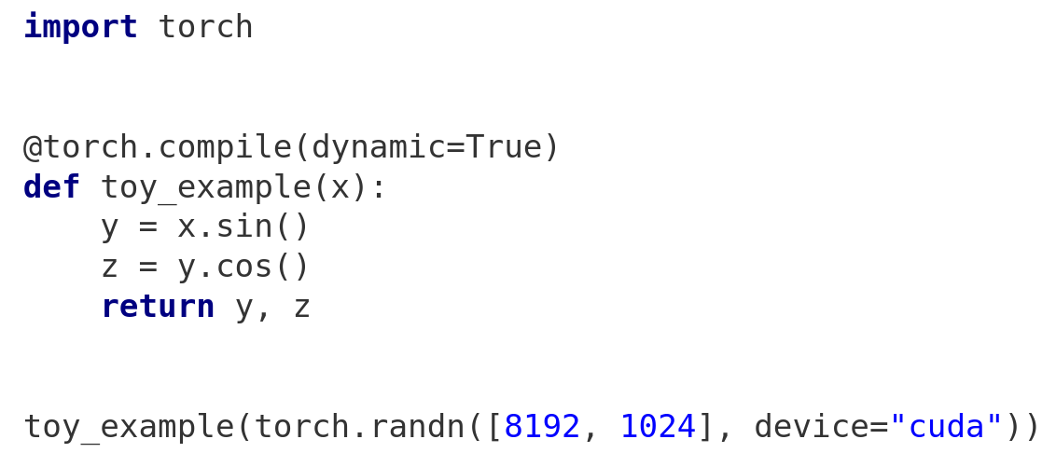
TorchInductor Example
Input Code | ATen FX Graph | Define-by-run IR | Scheduling/Fusion | Output Triton | Output Wrapper
Run with:
TORCH_COMPILE_DEBUG=1 python inductor_demo.py
Notes:
http://hilite.me/
import torch
@torch.compile(dynamic=True)
def toy_example(x):
y = x.sin()
z = y.cos()
return y, z
toy_example(torch.randn([8192, 1024], device="cuda"))

Slide 7
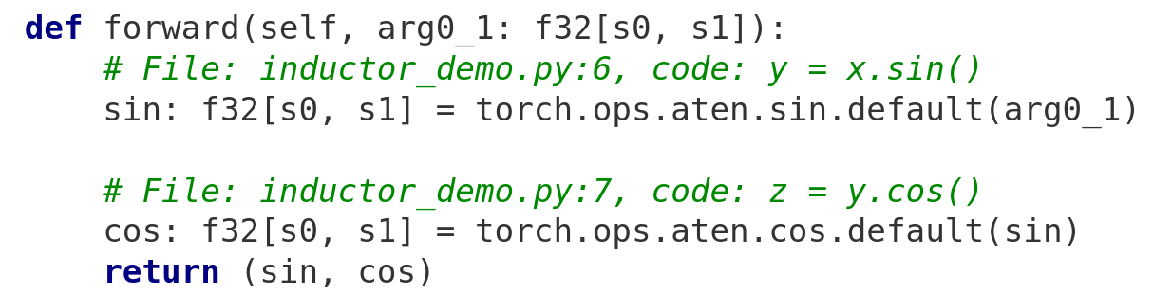
TorchInductor Example
Input Code | ATen FX Graph | Define-by-run IR | Scheduling/Fusion | Output Triton | Output Wrapper
Notes:
http://hilite.me/
class <lambda>(torch.nn.Module):
def forward(self, arg0_1: f32[s0, s1]):
# File: inductor_demo.py:6, code: y = x.sin()
sin: f32[s0, s1] = torch.ops.aten.sin.default(arg0_1); arg0_1 = None
# File: inductor_demo.py:7, code: z = y.cos()
cos: f32[s0, s1] = torch.ops.aten.cos.default(sin)
return (sin, cos)

Slide 8
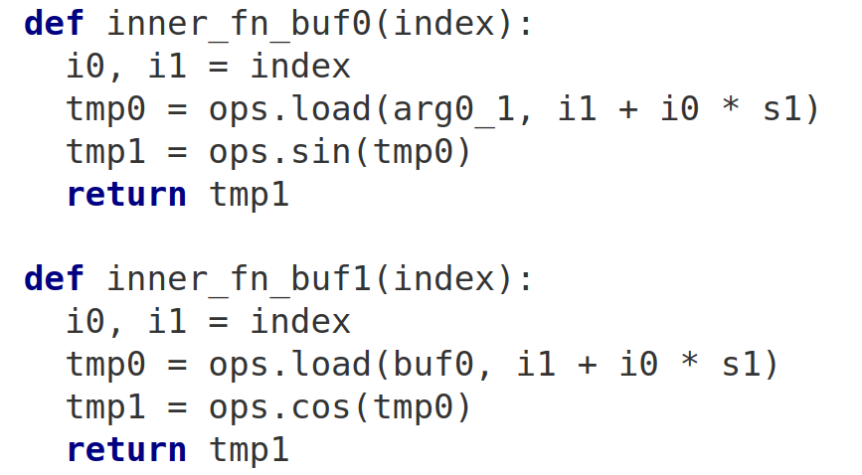
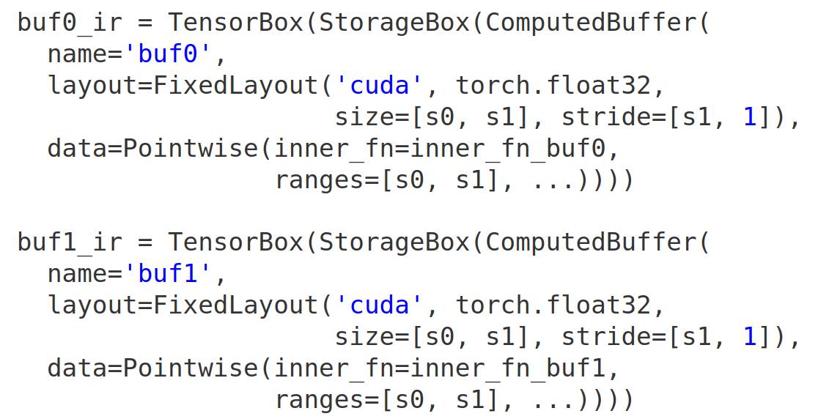
TorchInductor Example
Input Code | ATen FX Graph | Define-by-run IR | Scheduling/Fusion | Output Triton | Output Wrapper
Notes:
http://hilite.me/
def inner_fn_buf0(index):
i0, i1 = index
tmp0 = ops.load(arg0_1, i1 + i0 * s1)
tmp1 = ops.sin(tmp0)
return tmp1
def inner_fn_buf1(index):
i0, i1 = index
tmp0 = ops.load(buf0, i1 + i0 * s1)
tmp1 = ops.cos(tmp0)
return tmp1
buf0_ir = TensorBox(StorageBox(ComputedBuffer(
name='buf0',
layout=FixedLayout('cuda', torch.float32,
size=[s0, s1], stride=[s1, 1]),
data=Pointwise(inner_fn=inner_fn_buf0,
ranges=[s0, s1], ...))))
buf1_ir = TensorBox(StorageBox(ComputedBuffer(
name='buf1',
layout=FixedLayout('cuda', torch.float32,
size=[s0, s1], stride=[s1, 1]),
data=Pointwise(inner_fn=inner_fn_buf1,
ranges=[s0, s1], ...))))

Slide 9
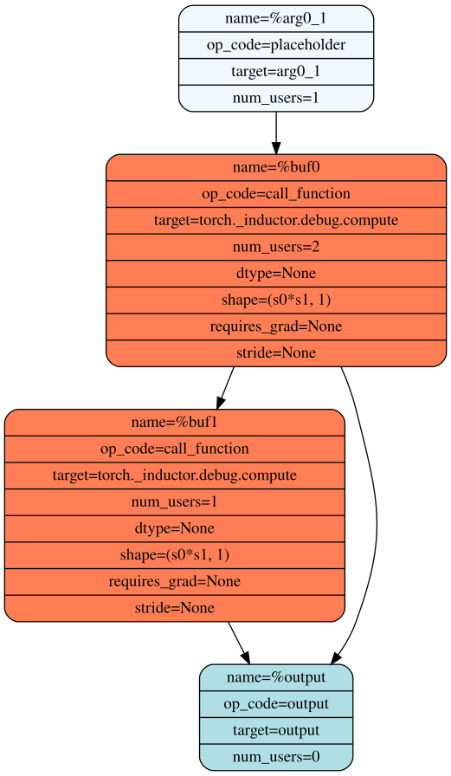
TorchInductor Example
Input Code | ATen FX Graph | Define-by-run IR | Scheduling/Fusion | Output Triton | Output Wrapper
torch/_inductor/scheduler.py
Scheduler.can_fuse(buf0, buf1)
True
Scheduler.score_fusion(buf0, buf1)
(True, True, 33554432, -1)
True/True is category of fusion (pointwise+pointwise)
33554432 is estimated memory bandwidth saved by fusion: 8192*1024*4
-1 is distance in input graph
Notes:
http://hilite.me/

Slide 10
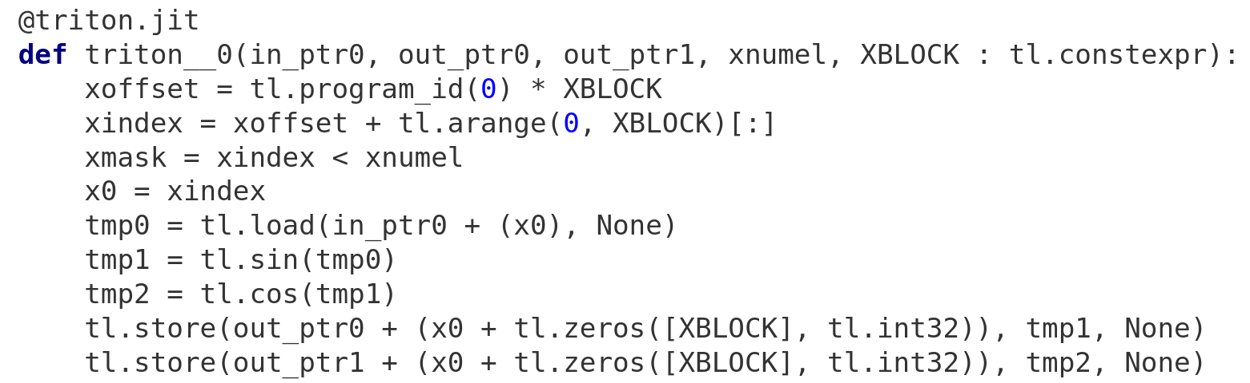
TorchInductor Example
Input Code | ATen FX Graph | Define-by-run IR | Scheduling/Fusion | Output Triton | Output Wrapper
Notes:
from ctypes import c_void_p, c_long
import torch
import math
import random
from torch import empty_strided, as_strided, device
from torch._inductor.codecache import AsyncCompile
from torch._inductor.select_algorithm import extern_kernels
aten = torch.ops.aten
assert_size_stride = torch._C._dynamo.guards.assert_size_stride
async_compile = AsyncCompile()
import triton
import triton.language as tl
from torch._inductor.triton_ops.autotune import grid, start_graph, end_graph
from torch._C import _cuda_getCurrentRawStream as get_cuda_stream
# kernel path: /tmp/torchinductor_jansel/k7/ck7ijvkk2h4k3eccu6vgyq7rxsv3crfbb3rozmvw4wijmvtw3zwt.py
triton__0 = async_compile.triton('''
import triton
import triton.language as tl
from torch._inductor.ir import ReductionHint
from torch._inductor.ir import TileHint
from torch._inductor.triton_ops.autotune import pointwise
from torch._inductor.utils import instance_descriptor
@pointwise(size_hints=[8388608], filename=__file__, meta={'signature': {0: '*fp32', 1: '*fp32', 2: '*fp32', 3: 'i32'}, 'device': 0, 'constants': {}, 'mutated_arg_names': [], 'configs': [instance_descriptor(divisible_by_16=(0, 1, 2, 3), equal_to_1=())]})
@triton.jit
def triton_(in_ptr0, out_ptr0, out_ptr1, xnumel, XBLOCK : tl.constexpr):
xoffset = tl.program_id(0) * XBLOCK
xindex = xoffset + tl.arange(0, XBLOCK)[:]
xmask = xindex < xnumel
x0 = xindex
tmp0 = tl.load(in_ptr0 + (x0), None)
tmp1 = tl.sin(tmp0)
tmp2 = tl.cos(tmp1)
tl.store(out_ptr0 + (x0 + tl.zeros([XBLOCK], tl.int32)), tmp1, None)
tl.store(out_ptr1 + (x0 + tl.zeros([XBLOCK], tl.int32)), tmp2, None)
''')
async_compile.wait(globals())
del async_compile
def call(args):
arg0_1, = args
args.clear()
arg0_1_size = arg0_1.size()
s0 = arg0_1_size[0]
s1 = arg0_1_size[1]
with torch.cuda._DeviceGuard(0):
torch.cuda.set_device(0) # no-op to ensure context
buf0 = empty_strided((s0, s1), (s1, 1), device='cuda', dtype=torch.float32)
buf1 = empty_strided((s0, s1), (s1, 1), device='cuda', dtype=torch.float32)
triton__0_xnumel = s0*s1
stream0 = get_cuda_stream(0)
triton__0.run(arg0_1, buf0, buf1, triton__0_xnumel, grid=grid(triton__0_xnumel), stream=stream0)
del arg0_1
return (buf0, buf1, )
if __name__ == "__main__":
from torch._dynamo.testing import rand_strided
from torch._inductor.utils import print_performance
arg0_1 = rand_strided((8192, 1024), (1024, 1), device='cuda:0', dtype=torch.float32)
print_performance(lambda: call([arg0_1]))

Slide 11
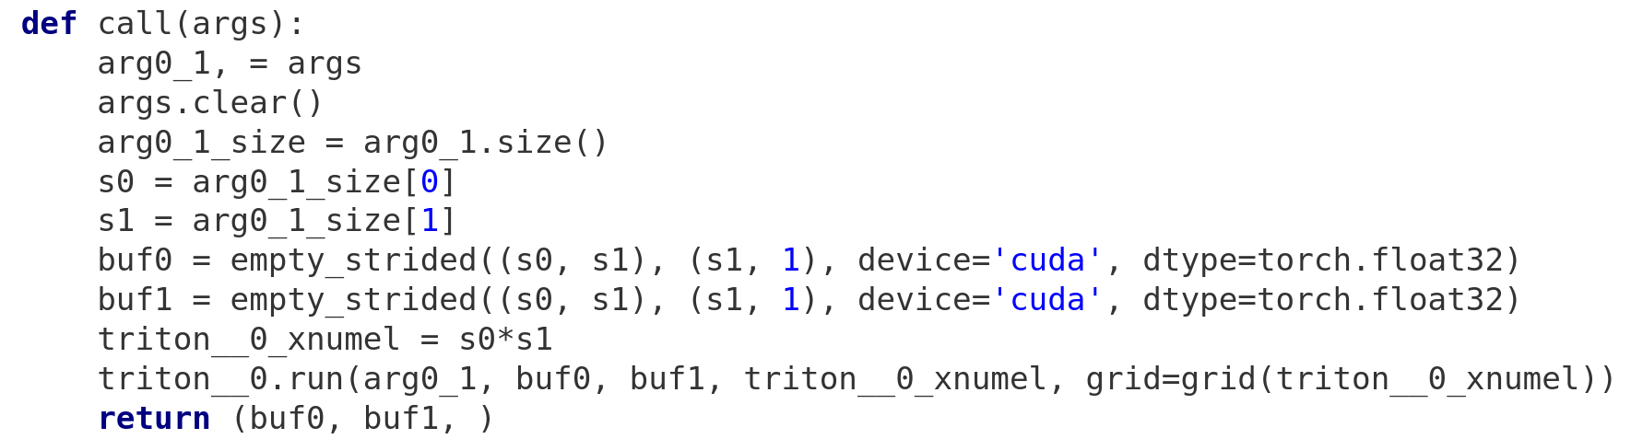
TorchInductor Example
Input Code | ATen FX Graph | Define-by-run IR | Scheduling/Fusion | Output Triton | Output Wrapper
Notes:
from ctypes import c_void_p, c_long
import torch
import math
import random
from torch import empty_strided, as_strided, device
from torch._inductor.codecache import AsyncCompile
from torch._inductor.select_algorithm import extern_kernels
aten = torch.ops.aten
assert_size_stride = torch._C._dynamo.guards.assert_size_stride
async_compile = AsyncCompile()
import triton
import triton.language as tl
from torch._inductor.triton_ops.autotune import grid, start_graph, end_graph
from torch._C import _cuda_getCurrentRawStream as get_cuda_stream
# kernel path: /tmp/torchinductor_jansel/k7/ck7ijvkk2h4k3eccu6vgyq7rxsv3crfbb3rozmvw4wijmvtw3zwt.py
triton__0 = async_compile.triton('''
import triton
import triton.language as tl
from torch._inductor.ir import ReductionHint
from torch._inductor.ir import TileHint
from torch._inductor.triton_ops.autotune import pointwise
from torch._inductor.utils import instance_descriptor
@pointwise(size_hints=[8388608], filename=__file__, meta={'signature': {0: '*fp32', 1: '*fp32', 2: '*fp32', 3: 'i32'}, 'device': 0, 'constants': {}, 'mutated_arg_names': [], 'configs': [instance_descriptor(divisible_by_16=(0, 1, 2, 3), equal_to_1=())]})
@triton.jit
def triton_(in_ptr0, out_ptr0, out_ptr1, xnumel, XBLOCK : tl.constexpr):
xoffset = tl.program_id(0) * XBLOCK
xindex = xoffset + tl.arange(0, XBLOCK)[:]
xmask = xindex < xnumel
x0 = xindex
tmp0 = tl.load(in_ptr0 + (x0), None)
tmp1 = tl.sin(tmp0)
tmp2 = tl.cos(tmp1)
tl.store(out_ptr0 + (x0 + tl.zeros([XBLOCK], tl.int32)), tmp1, None)
tl.store(out_ptr1 + (x0 + tl.zeros([XBLOCK], tl.int32)), tmp2, None)
''')
async_compile.wait(globals())
del async_compile
def call(args):
arg0_1, = args
args.clear()
arg0_1_size = arg0_1.size()
s0 = arg0_1_size[0]
s1 = arg0_1_size[1]
with torch.cuda._DeviceGuard(0):
torch.cuda.set_device(0) # no-op to ensure context
buf0 = empty_strided((s0, s1), (s1, 1), device='cuda', dtype=torch.float32)
buf1 = empty_strided((s0, s1), (s1, 1), device='cuda', dtype=torch.float32)
triton__0_xnumel = s0*s1
stream0 = get_cuda_stream(0)
triton__0.run(arg0_1, buf0, buf1, triton__0_xnumel, grid=grid(triton__0_xnumel), stream=stream0)
del arg0_1
return (buf0, buf1, )
if __name__ == "__main__":
from torch._dynamo.testing import rand_strided
from torch._inductor.utils import print_performance
arg0_1 = rand_strided((8192, 1024), (1024, 1), device='cuda:0', dtype=torch.float32)
print_performance(lambda: call([arg0_1]))

Slide 12
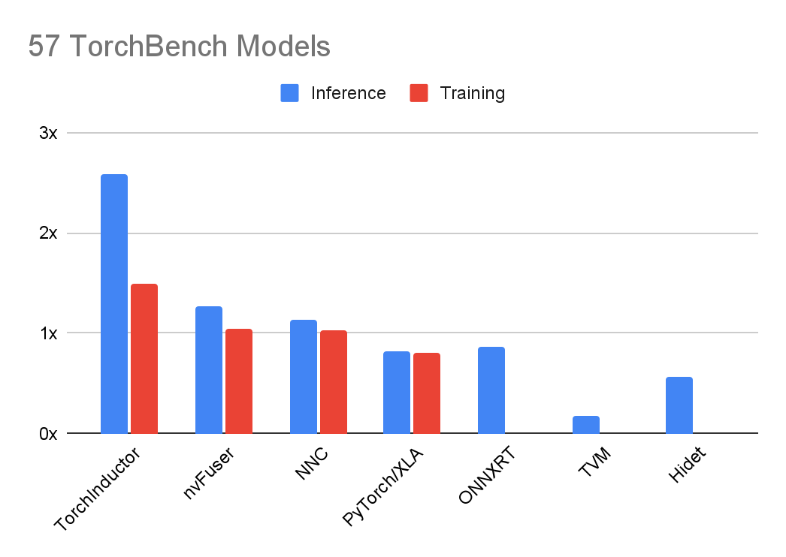
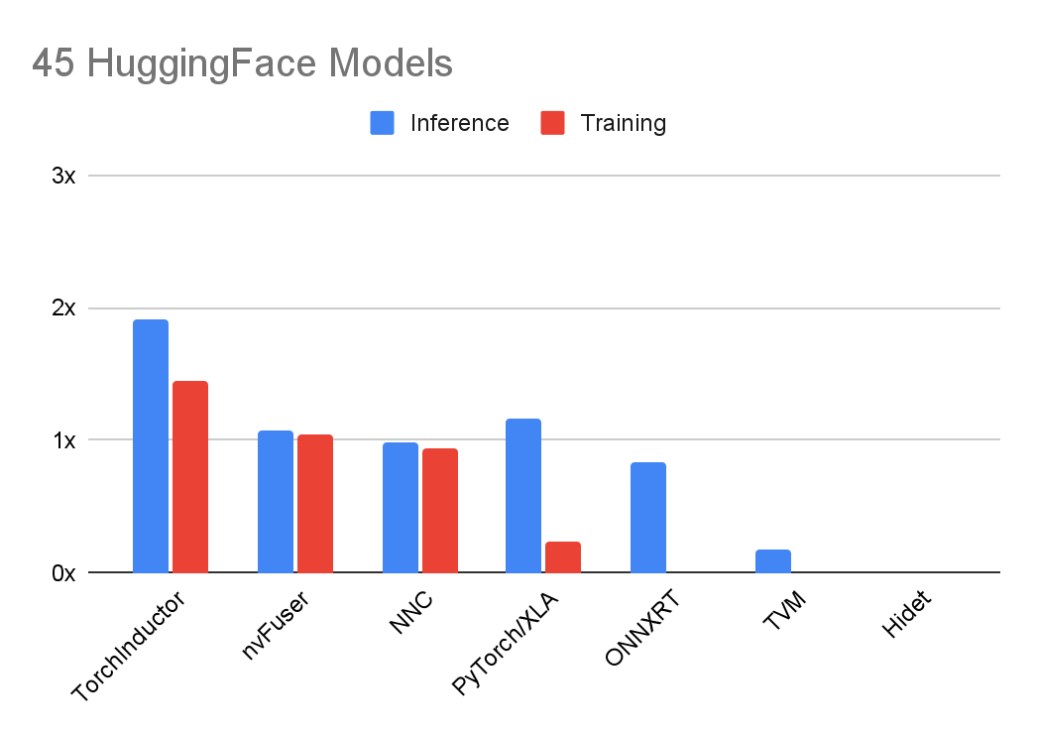
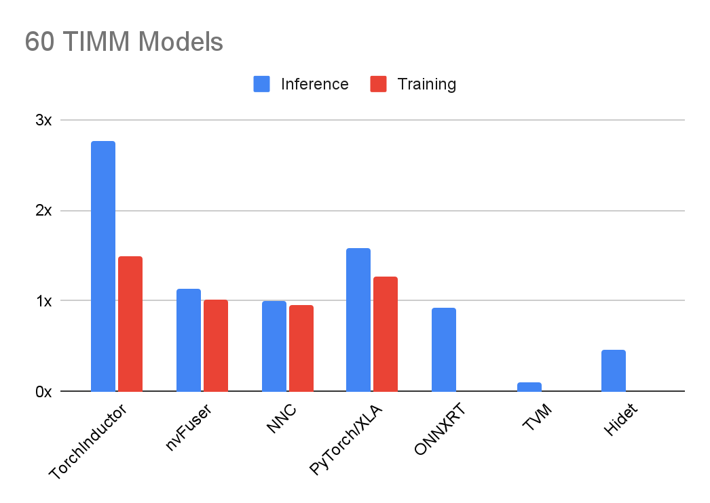
NVIDIA A100 PERFORMANCE
Geomean speedup over PyTorch eager using float16
Higher is better

Slide 13
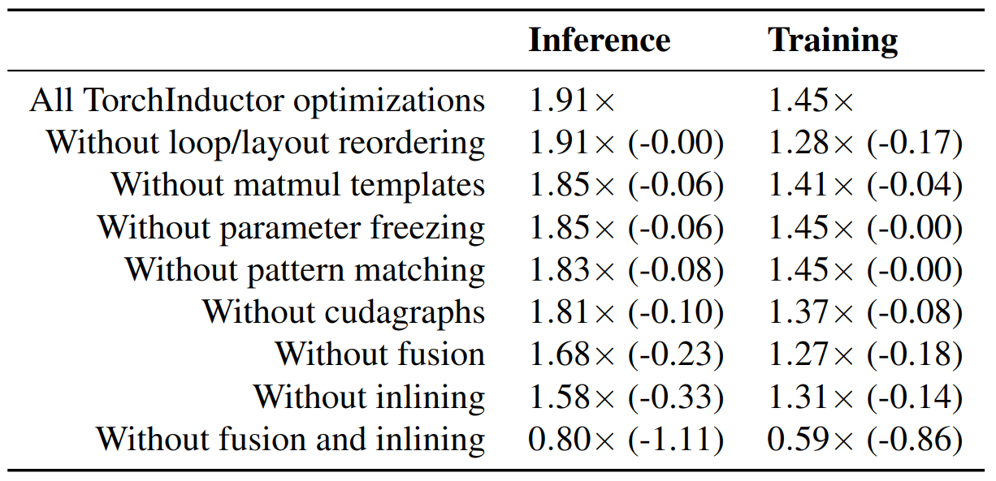
NVIDIA A100 PERFORMANCE
Geomean speedup over PyTorch eager on 45 models from HuggingFace using fp16

Slide 14
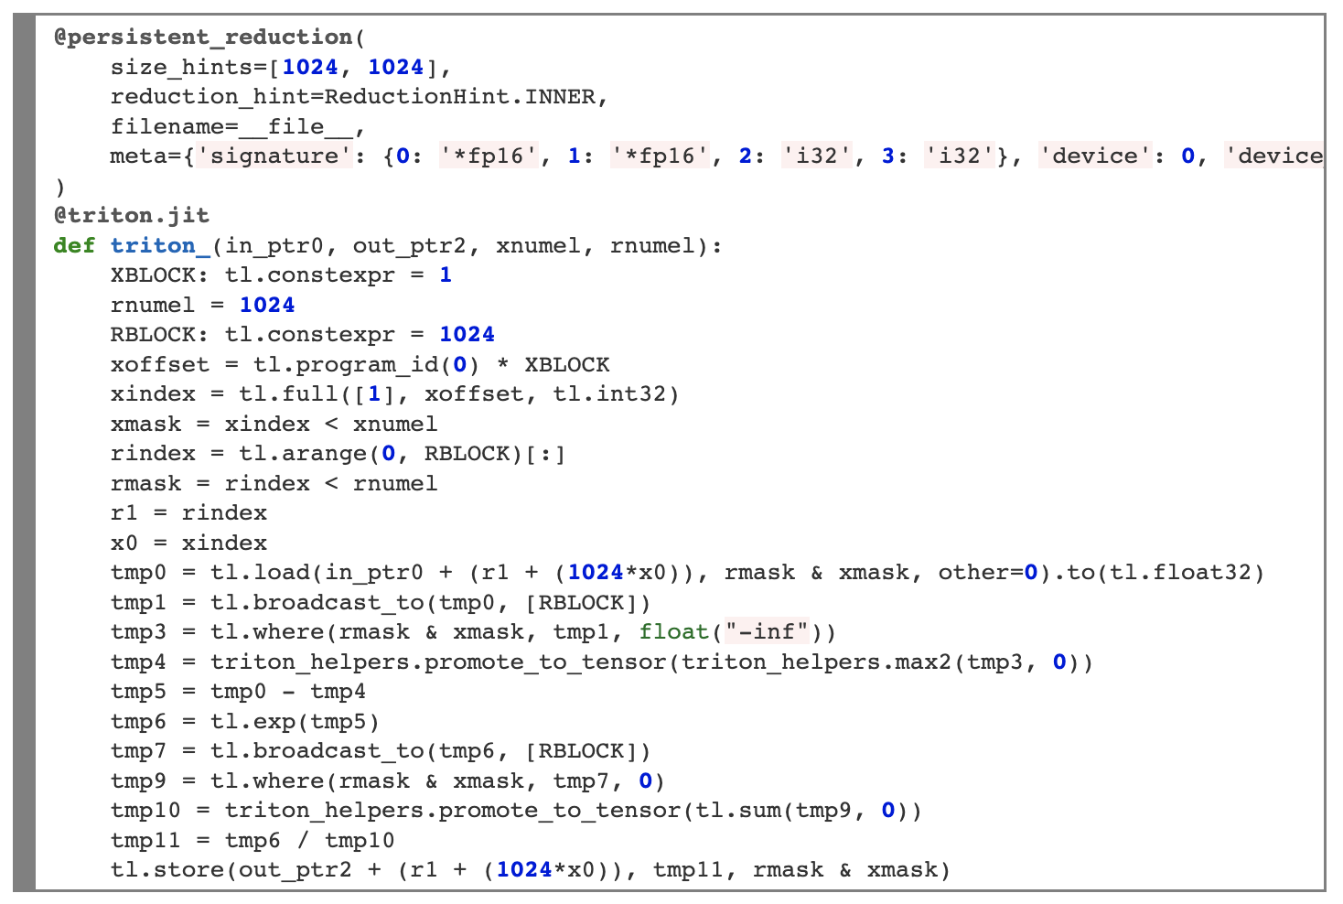
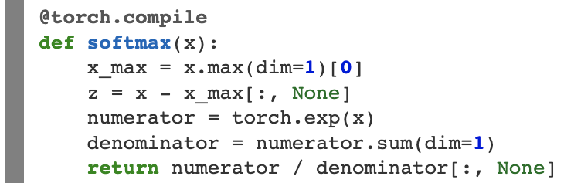
What Inductor can do with Triton: Softmax
Dynamic Shapes!
Notes:
So, to give an example of how a more complicated kernel might look, let’s bring it full circle and look at one of the original examples in the Triton blog post. If we look at the Triton code that’s generated, the generated Inductor code, which supports symbolic shapes, looks very close to what a human may write (albeit perhaps with less informative variable names).

Slide 15
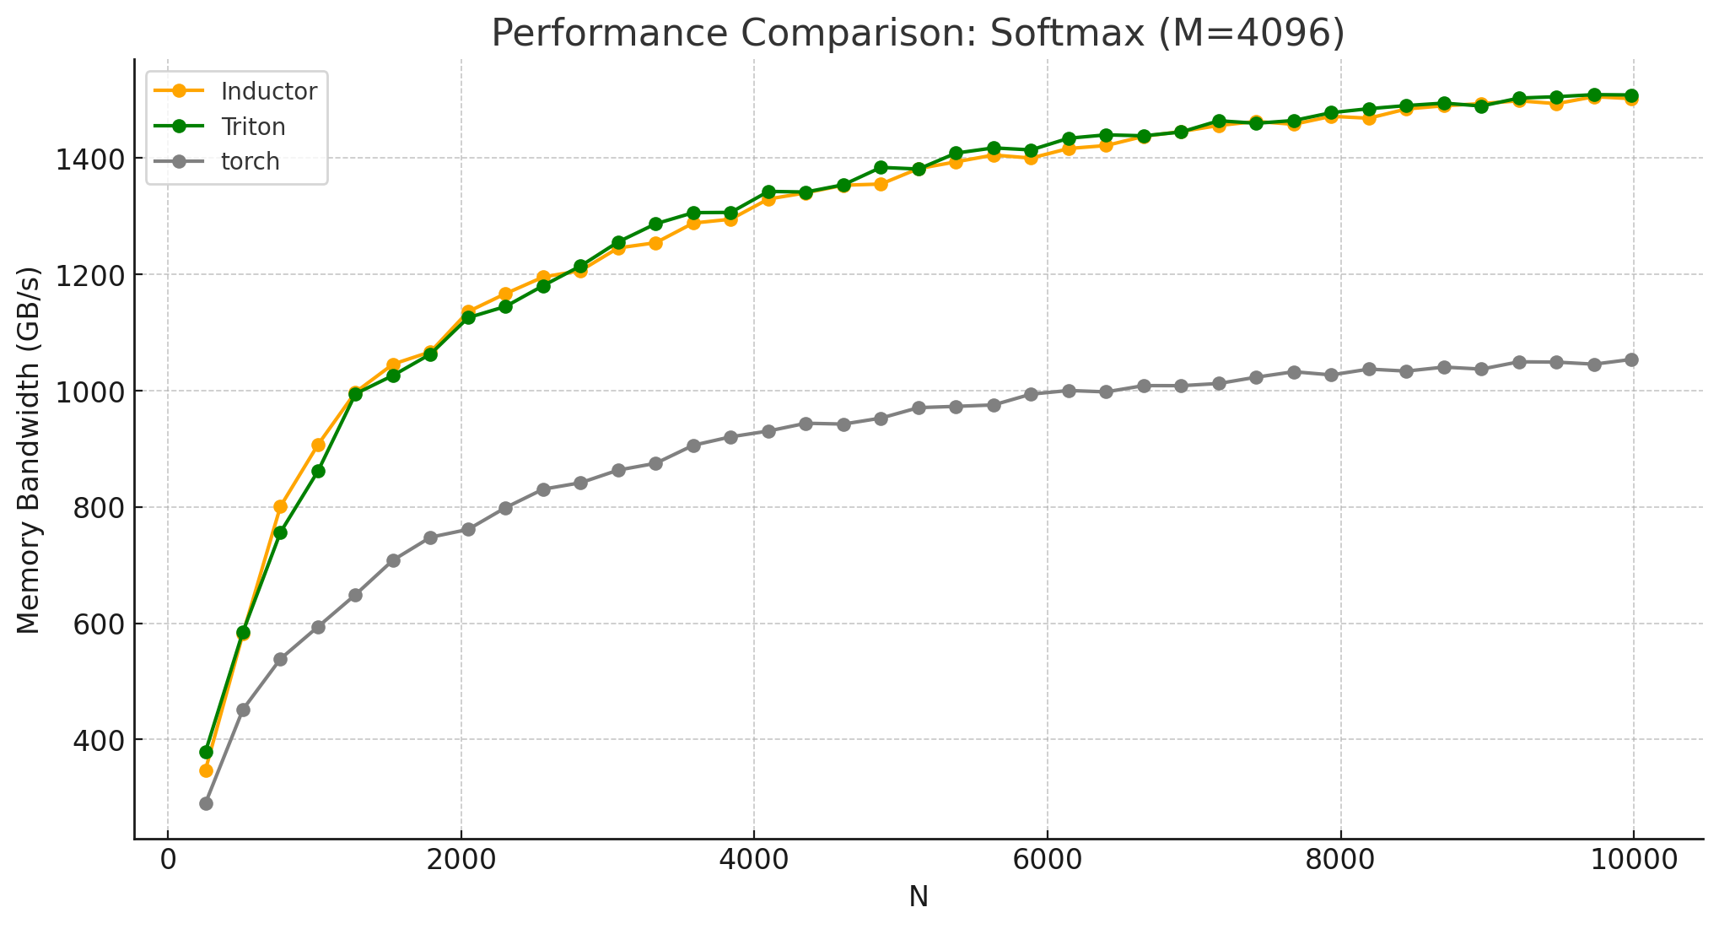
What Inductor can do with Triton: Softmax
Notes:
Unsurprisingly, Inductor closely matches the performance of the original Triton kernel.

Slide 16
What Inductor can do with Triton: Softmax
Dynamic Shapes!
Notes:
So, to give an example of how a more complicated kernel might look, let’s bring it full circle and look at one of the original examples in the Triton blog post. If we look at the Triton code that’s generated, the generated Inductor code, which supports symbolic shapes, looks very close to what a human may write (albeit perhaps with less informative variable names).

Slide 17
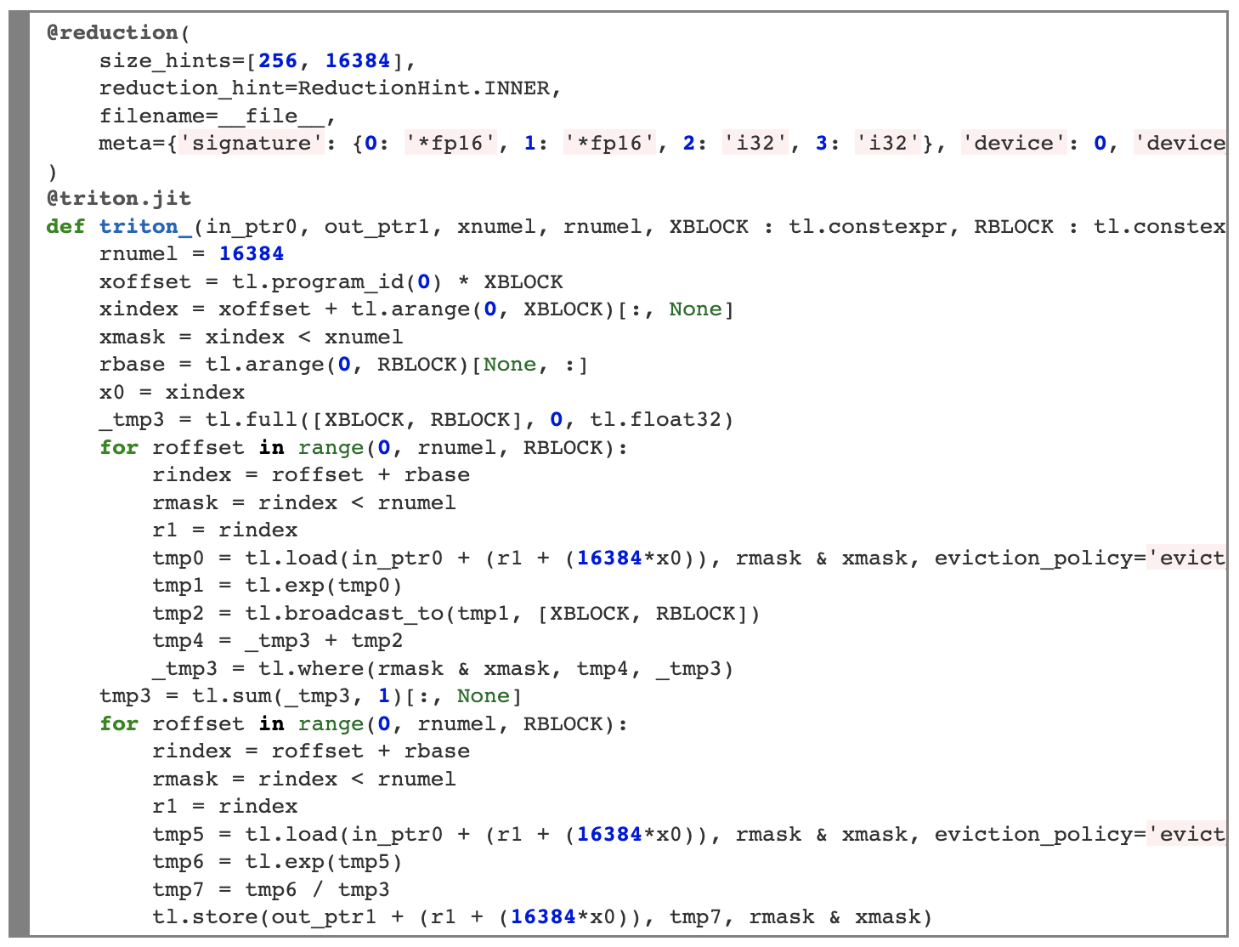
What Inductor can do with Triton: Softmax
Non-persistent reductions!

Slide 18
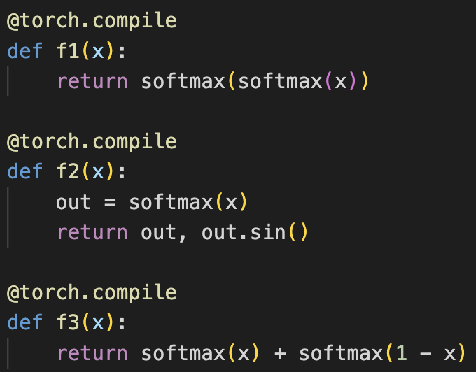
What Inductor can do with Triton: Softmax Variants
Single Triton Kernel!

Slide 19
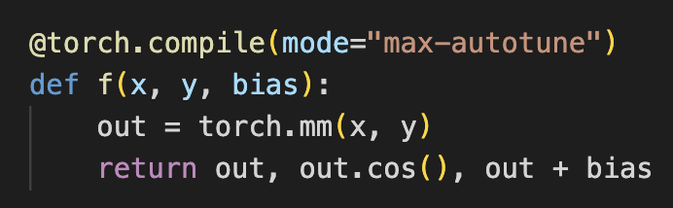
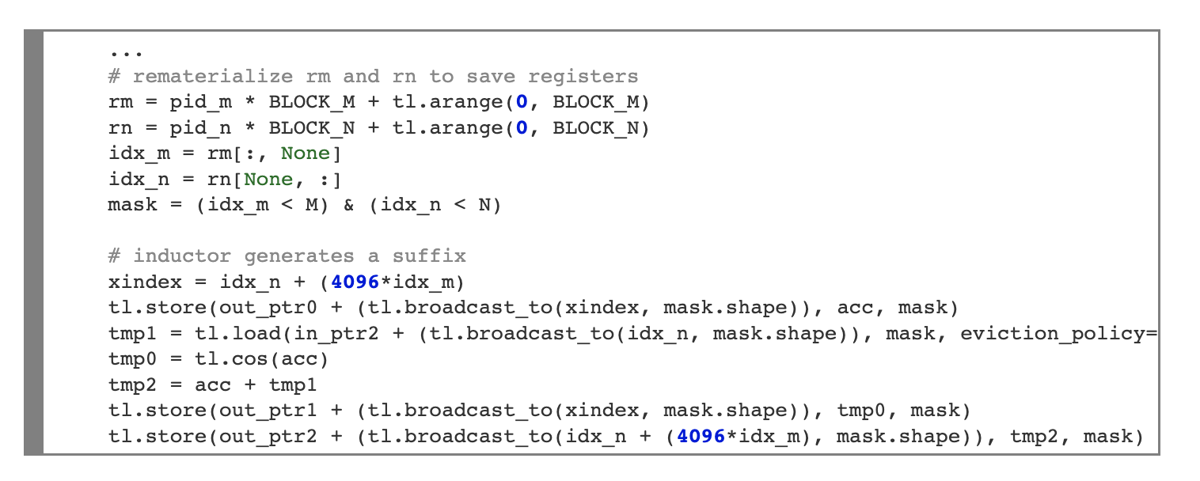
What Inductor can do with Triton: Templates
Handwritten template code!
Automatically generated suffix, reading in an extra input and writing two outputs

Slide 20
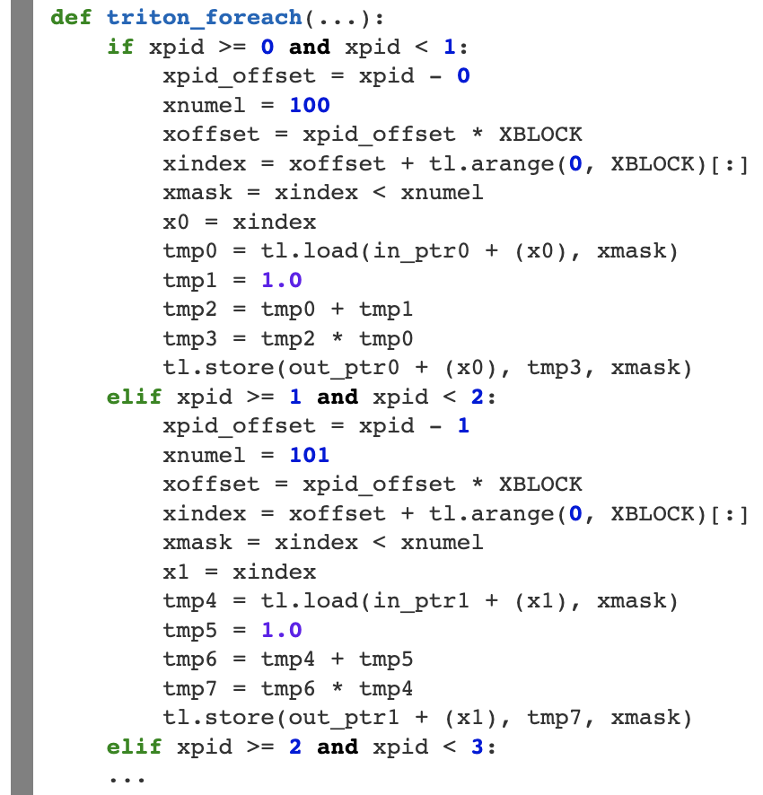
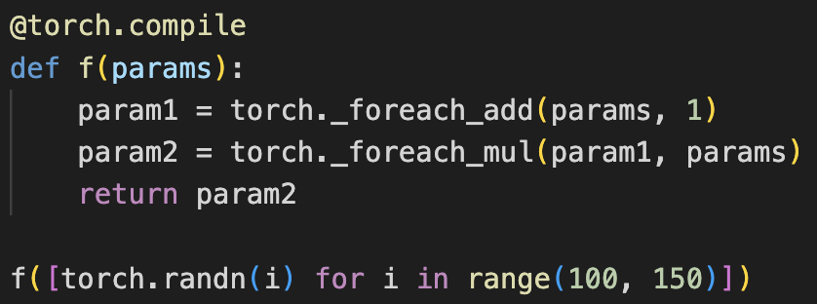
What Inductor can do with Triton: For-Each Kernels
Taking advantage of block-level control flow!

Slide 21
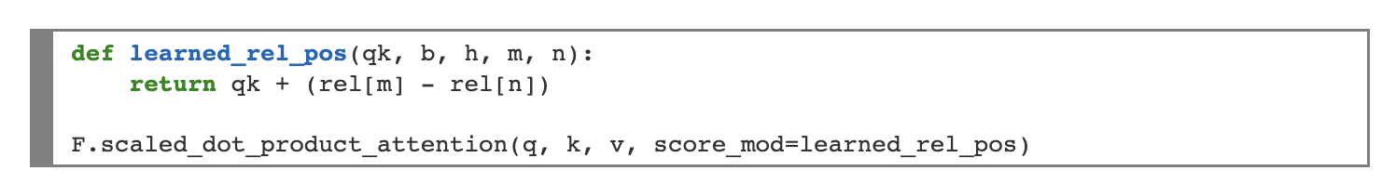
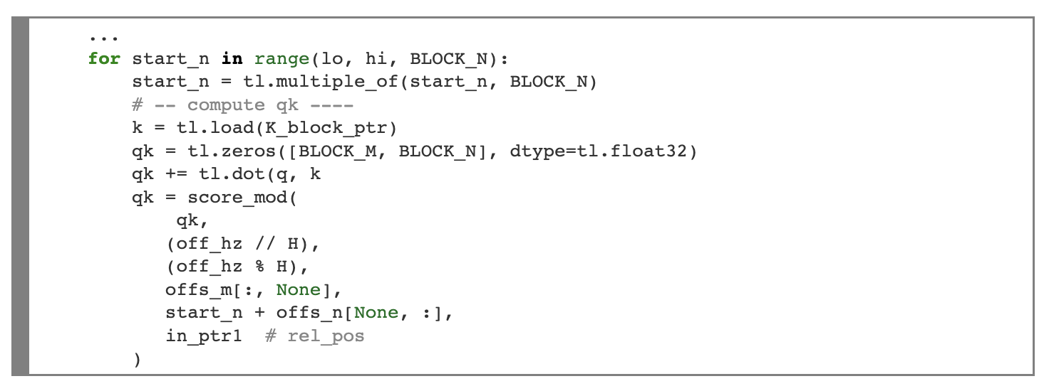
What Inductor can do with Triton: Parameterized Operators [WIP]
Captured tensors!

Slide 22
What Inductor can do with Triton: Near Full Conversion from PyTorch into Triton
torch.compile(resnet18)
torch.compile(llama_decode)
Inductor
Inductor
aten.convolution
30 Triton Kernels
aten.topk + aten.sdpa
23 Triton Kernels

Slide 23
PyTorch 2.0:
https://pytorch.org/get-started/pytorch-2.0/
PyTorch Conference Oct 16-17
https://pytorch.org/blog/pytorch-conference-2023/
Code:
https://github.com/pytorch/pytorch/tree/master/torch/_inductor
PyTorch is hiring! Email divyavenkat@meta.com if interested.

